Slide 1

Title and The Problem Statement
Project: Village Economic Growth Intelligence
Task: To identify and rank the top 100 economically growing villages using multi-temporal satellite imagery and open-source geospatial datasets.

Slide 2
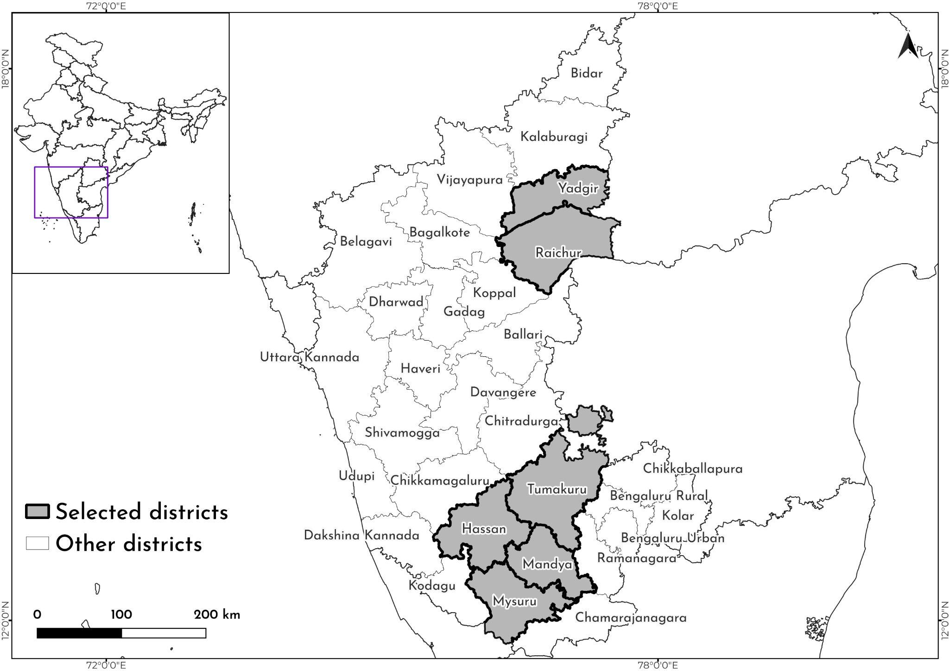
Study Area and Prototyping Strategy
India has more than 600,000 villages.
Processing satellite imagery over such a vast geographical extent requires significant computational resources and processing time.
Therefore, this study developed a scalable methodology, which was tested across six randomly selected districts of Karnataka covering more than 9,000 villages.
The selected districts are Hassan, Mandya, Mysuru, Raichur, Tumakuru, and Yadgir, which are highlighted in the map
Fig 1: Selected districts of Karnataka
Economic growth is defined as the physical, measurable transition of a village's landscape rather than just a traditional income statistic. It is measured as a multidimensional spatial reality by combining early-stage capital investment (expanding road networks) and mature wealth accumulation (new concrete built-up areas and increased nightlight radiance)."

Slide 3
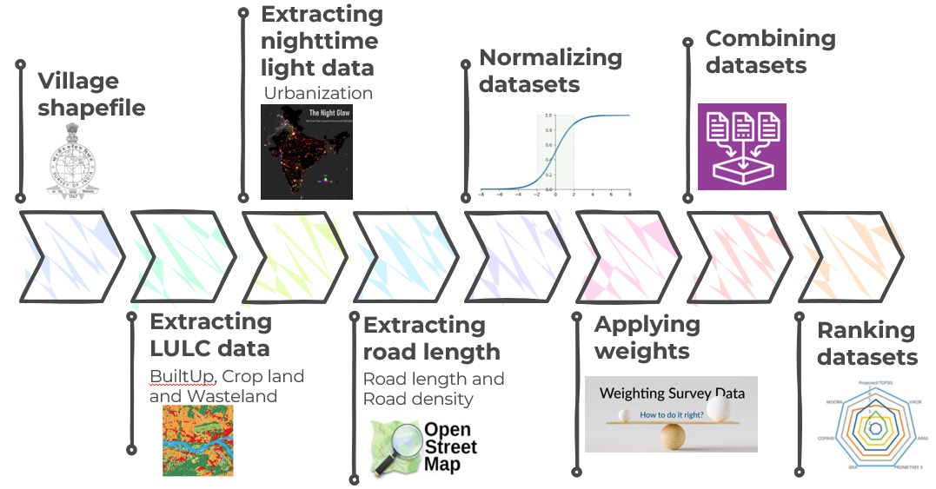
Geospatial Data Pipeline and Ranking Methodology
Datasets used | Source
Village shapefile | Survey of India
LULC | Dynamic World (10m)
Nightlight data | VIIRS (500m)
Road network | OSM
Datasets were extracted for the year 2021 and 2025
Fig 2: Methodology
Note 1: Village-level LULC data were extracted for the classes Built-up, Cropland, and Wasteland. These classes were selected based on their influence on the economic development of the village.
Note 2: Road length (in km) extracted at the village level was converted into road density (km/sq. km) to minimize size bias between larger and smaller villages.

Slide 4
Geospatial Data Pipeline and Ranking Methodology
Ranking methodology: The TOPSIS Approach- A Multi-Criteria Decision Making (MCDM) algorithm that ranks alternatives based on their geometric distance to theoretical extremes.
Data Integration: Normalizes disparate datasets (area, radiance, density) onto a unified 0 to 1 scale. It applies expert weights to merge all variables into a single, 5-dimensional mathematical space.
Normalization
Weighting Strategy
a) Normalization
To standardize the dataset for ranking, the absolute change (the difference between 2025 and 2021) was calculated for all parameters. The indicators were then classified by their economic impact:
Positive Indicators: Built-up area, crop land, median nightlights, and road density were classified as positive drivers. An increase in these metrics signifies improving economic conditions and infrastructural expansion.
Negative Indicators: Wasteland expansion was classified as a negative indicator, as an increase suggests agrarian decline or a reduction in productive economic activity.
To ensure all variables carried equal weight regardless of their raw units, Min-Max Normalization was applied. All absolute values were scaled to a strict 0.0 to 1.0 index.

Slide 5
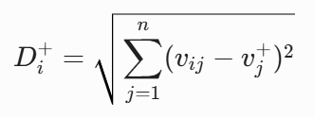
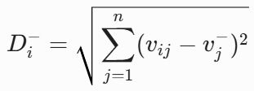
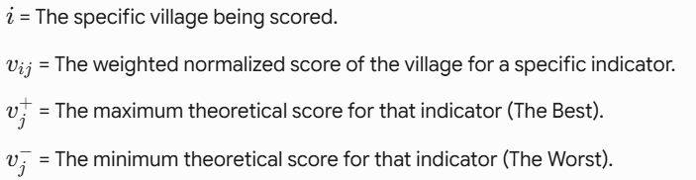

Geospatial Data Pipeline and Ranking Methodology
b) Weighting Strategy
Initial Model (PCA): Principal Component Analysis was run to objectively extract variance-based weights, removing random human bias.
The Statistical Reality: PCA assigned disproportionate weight (55.7%) to Road Density due to high spatial variance in the OSM data.
To prevent the model from becoming a pure "Infrastructure Index," weights were manually recalibrated.
Class | PCA weights (%) | Recalibrated weights (%)
BuiltUp | 13.3 | 25
CropLand | 15.1 | 15
Wasteland | 1.5 | 5
Night light | 14.4 | 20
Road density | 55.7 | 35
3) The Ranking Strategy: Identifies the Positive Ideal (maximum growth across all indicators) and the Negative Ideal (total stagnation/decline).Calculates the Euclidean distance from each village to both extremes.
4) The Final Score: Villages are ranked using a "Closeness Coefficient(Ci) ." This mathematically rewards balanced, holistic growth while heavily penalizing extreme weaknesses.
Distance to the Ideal Best Distance to the Ideal Worst

Slide 6
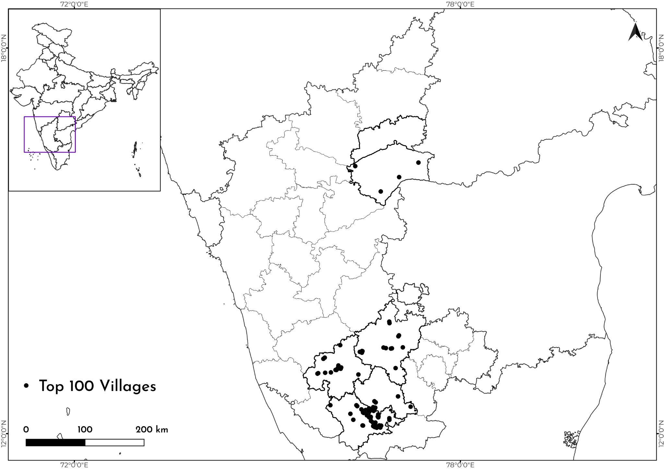
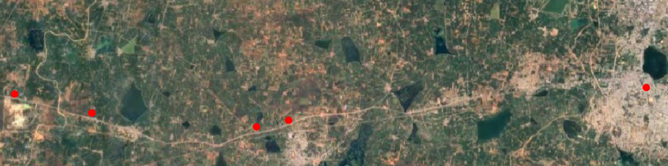
Results and Discussions
Village | Block | District | Rank | TOPSIS Score
Annapura | Tiptur | Tumakuru | 1 | 0.590
Deveerammanahalli | Nanjangud | Mysuru | 2 | 0.581
Krishnarajanagara |  | Mysuru | 3 | 0.566
Belavadi | Mysore | Mysuru | 4 | 0.561
Nanjangud |  | Mysuru | 5 | 0.554
Fig 3: Map showing top 100 villages
The highest concentration of Top 100 villages is in the Mysuru district, directly reflecting its status as Karnataka's second fastest-growing economic hub.
Significant clustering observed in Tumakuru and Hassan. Growth here is distinctly linear, driven by National Highway connectivity to the Bengaluru metropolis.
Northern Karnataka shows sparse representation, aligning with known regional development lags. The few northern villages that made the Top 100 were propelled almost entirely by major interstate highway construction connecting to Pune and Hyderabad.

Slide 7
Limitations and Future Scope
The Decadal Requirement: A 5-year baseline (2021-2025) captures early-stage infrastructure but is insufficient for measuring mature urban sprawl. Future models require a 10+ year baseline.
Transitioning to Cropping Intensity: Static LULC classifications fail to capture agricultural economic depth. Future iterations will utilize multi-temporal imagery to calculate cropping intensity (single vs. double/triple cropping), which warrants a much higher weight in the economic index.
Hierarchical Infrastructure Weighting: Current OpenStreetMap historical extractions treat all road geometry equally. Future models will integrate road network typology to apply differential weights (e.g., distinguishing a multi-lane paved highway from an unpaved village track).
Data Source selection criteria
Data Source | Parameter Extracted | Justification for Selection
Survey of India (SOI) | Administrative Boundaries | The legally recognized, authoritative source for administrative boundaries in India.
Dynamic World (10m LULC) | Built-up, Cropland, Wasteland | Provides 10m resolution data necessary for capturing changes at the village level. Utilizing a globally validated LULC data eliminates massive processing overhead involved with generating LULC from scratch.
VIIRS (Stray-Light Corrected) | Nightlight Radiance | Offers superior spatial resolution (~500m) and radiometric calibration compared to legacy sensors. It avoids pixel saturation in dense areas, and the stray-light correction ensures highly accurate detection of faint rural electrification and subtle economic shifts.
OpenStreetMap (OSM) | Historical Road Density | An open-source, highly granular database that captures minor village tracks and unpaved roads often missed by commercial datasets. Crucially, it supports temporal querying, allowing for exact historical baseline comparisons.

Slide 8
Thank you

